Slide 1
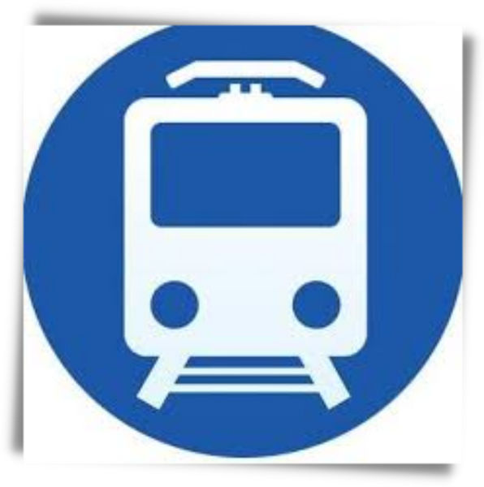

RAILWAY ENQUIRY SYSTEM
1602-19-737-128 Bheeshma Udumula
1602-19-737-145 Nikitha Maramraju
1602-19-737-164 Ssantosh Kumar Soma

Slide 2

01
Problem Statement
Table of
Contents
02
Abstract
03
Actors
04
Use cases
05
Tech Stack
06
Overall Architecture
RAILWAY ENQUIRY SYSTEM

Slide 3



Service quality is the most important factor for the passenger’s satisfaction. India has biggest railway network across the country and in the whole world. The purpose of this project is to enhance the service quality of Railway Enquiry System and to attain the passenger's satisfaction.
In this project we provide users with the details of a train and various functions related to it.
Problem Statement
RAILWAY ENQUIRY SYSTEM

Slide 4
The Railway Enquiry System facilitates the passengers to enquire about the trains available on the basis of source and destination, Booked and Cancelled trains, enquire about the status of the booked ticket, locating the live station of the train and rescheduling of trains.
The aim of this project is to design and develop a web application for the users incorporated with these features.
This project uses various available Railway API's provided by IRCTC.
Abstract

Slide 5


Actors
People who use or interact with our application
USER
SYSTEM
RAILWAY ENQUIRY SYSTEM

Slide 6





Use Cases
Find train by name
Live station
Train schedule
Find stations
Find train by number
Rescheduled Trains
PNR Status
Diverted Trains
RAILWAY ENQUIRY SYSTEM

Slide 7



Framework
Django
Tech Stack
Frontend
HTML CSS Bootstrap
Backend
Python
RAILWAY ENQUIRY SYSTEM

Slide 8




Request
Collect Data
Response
What the user sees and interacts with
Contains app logic
Python, JS
HTML, CSS, Bootstrap
Display Result
Frontend
Web Server
File system
HTML, CSS, images
API
Backend

